Slide 1

KOWIN Eastern Region
WASHINGTON D.C. CHAPTER
President: Myong Ho Nam, M.D.

Slide 2

[Reports on September – December, 2011 Activities]
2011 The Third Membership Meeting
  October 4, 2011 at Woo Lae Oak (Tyson’s Corner)
  Members Present: Myong Ho (Lucy) Nam (President), Jung-Sil Lee, Sami Lauri, Jina Kim, Kwang-Ja Kim, Eun Ae Lee, Junghee Lee, Myung Ja Lee, Meeree Ham, Florence Lowe-Lee, Sue-Kyong Shin Vittas, Susan Oh, Balbina Hwang, Kimberly Gube, Jung Ran Lim, Erika Shin (Fellow) & Guests: Ji-young Cho, Sara Yun, Young-eun Na
  Main Topics:
    Kimberly Gube and other participants’ presentation with picture slide show about 2011 Annual KOWIN International Convention in Ulsan, Korea
    Discussions, lead by this year’s Chair Balbina Hwang, on specific items of 2011 KOWIN DC Leadership Seminar (at the SAIS auditorium, DC, with the Sejong Society), such as the theme, the list of mentors, panelists, group mentoring organization, the career tracks to be represented, time frame, food catering, etc.
    Financial report, update on KOWIN DC website project, presentation by Jina Kim and Ji-young Cho on the Korean Service Foundation’s Fund Raising Banquet in 2012 Spring, and KASF’s Scholarship Award Banquet.

Slide 3
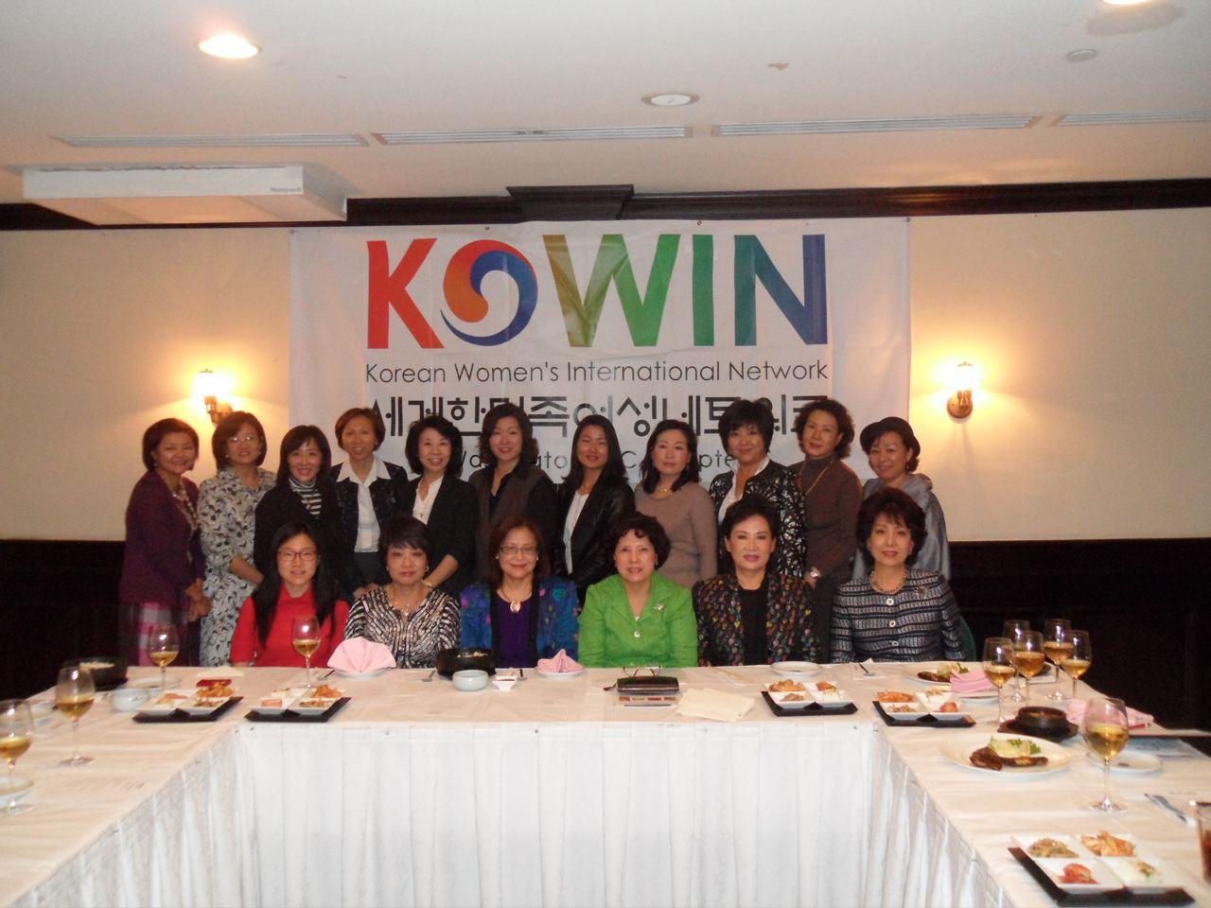

Slide 4
KOWIN DC Chapter E-Newsletter
  Published twice a year
    1st Volume: October, 2010
    2nd Volume: February, 2011
    3rd Volume: October, 2011
    4th Volume: February, 2012
  The Newsletters are delivered in both Korean and English to KOWIN DC Members and Friends of KOWIN DC

Slide 5
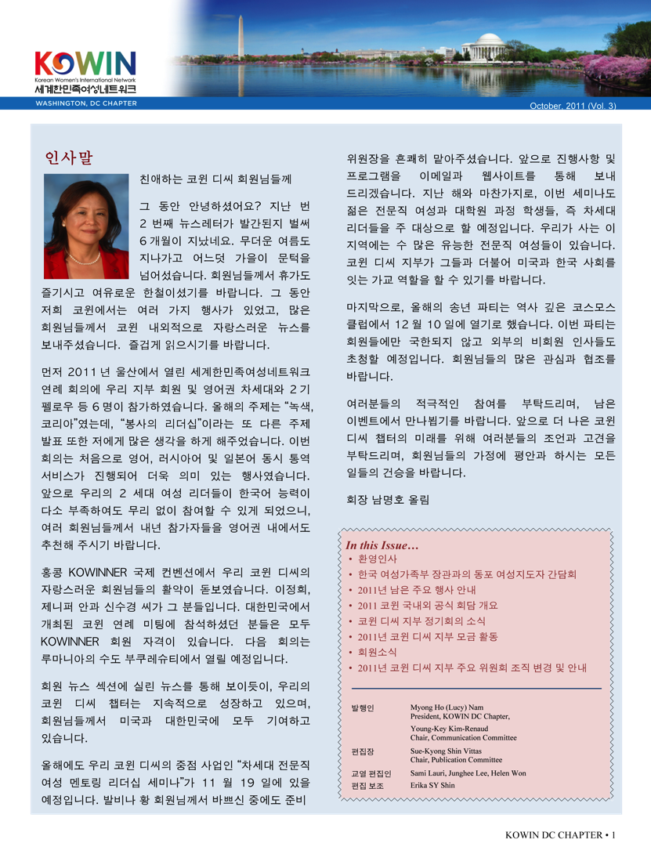
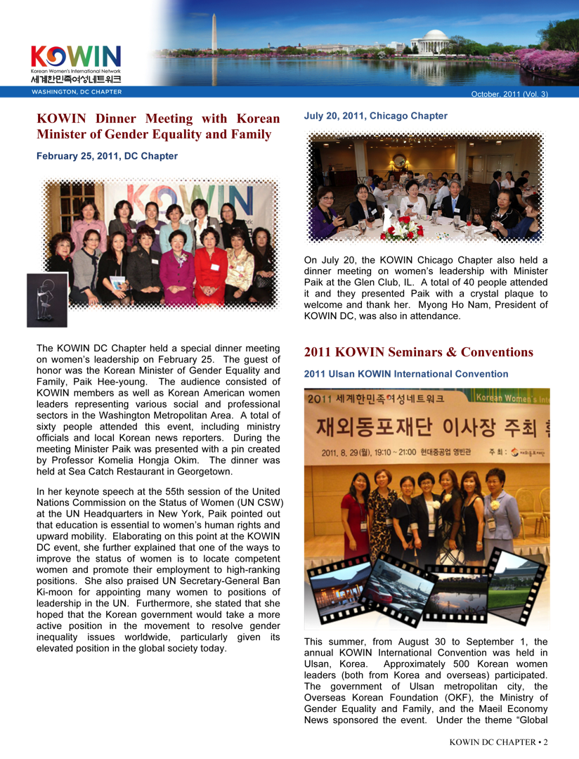

Slide 6
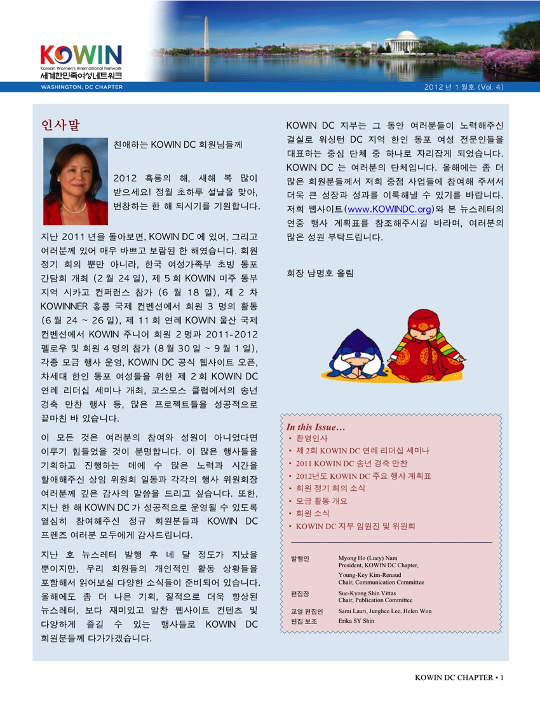
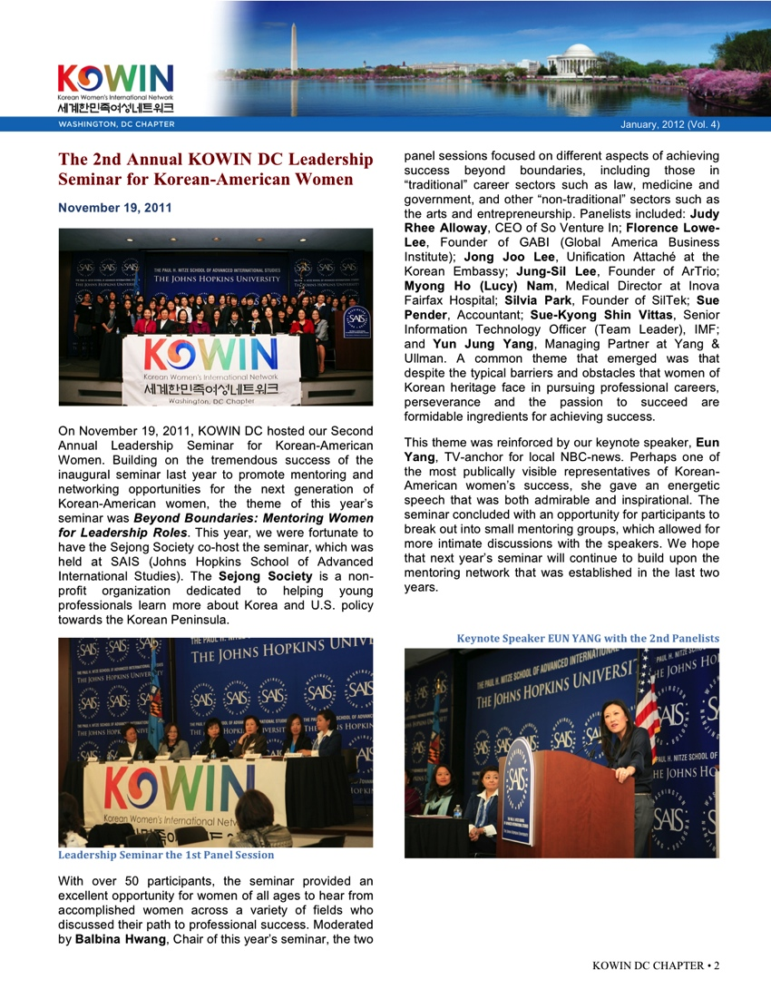

Slide 7
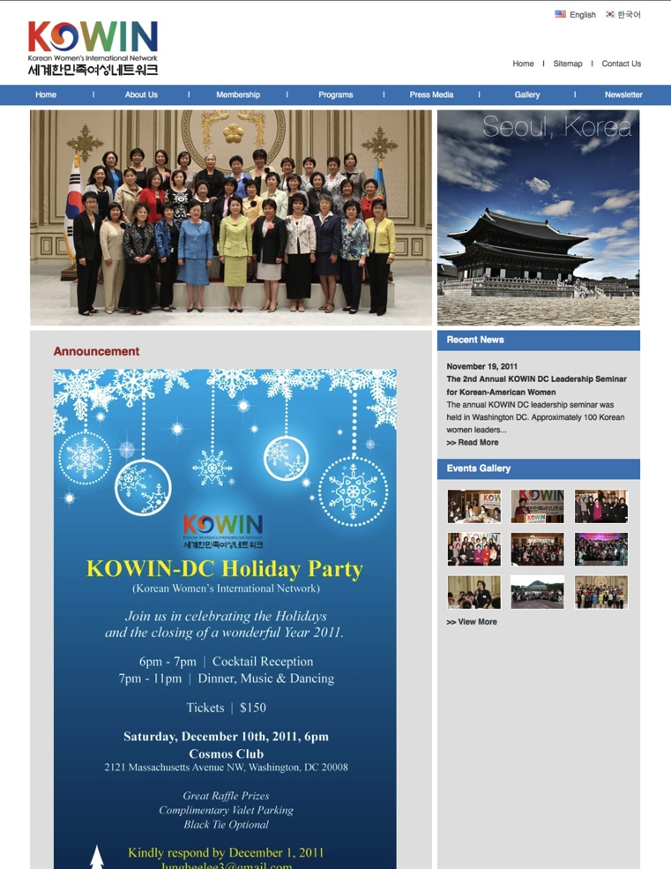

KOWIN DC Chapter Korean and English Website Opened on November 1st, 2011

Slide 8
[Reports on September – December, 2011 Activities]
Project: Young Women Leadership Seminar and Mentoring Program, “Beyond Boundaries”
Purpose
  To guide and support young, Korean women in their various professions in order to become worldwide leaders
Project Period
  October 19th, 2011 to November 19th, 2011
Main Content
  The event was held on November 19th, 2011 in the SAIS Kenney Auditorium
  Approximately 70 young professionals and interested women attended
  The Key Note Speaker: Eun Yang , Anchor Woman for Channel 4 News
  Panel Discussion Moderator: Dr. Young Kyung Hwang (Georgetown University Professor)
  About 10 women leaders presented as mentors from the following fields: Government, Medical, Media, and Academia. They spoke and gave advice about how to succeed as a young professional Korean woman leader in these fields

Slide 9
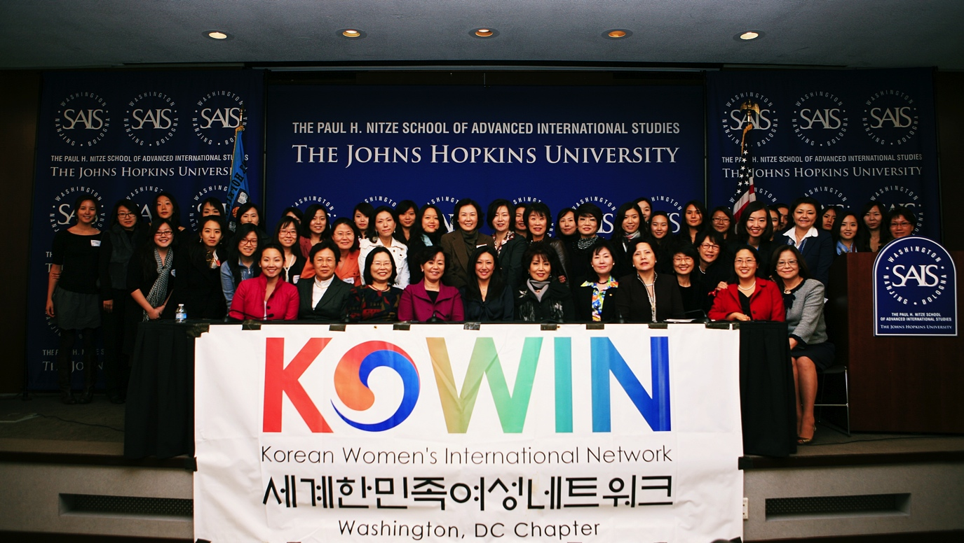
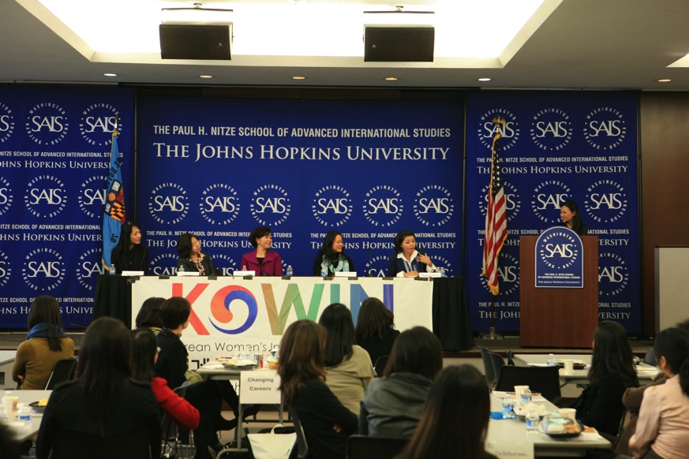

Slide 10
[Reports on September – December, 2011 Activities]
Project : KOWIN DC Christmas Gala (COSMOS CLUB)
Purpose
  End of Party and Social gathering to end the 2011 year
Project Date
  December 10th, 2011
Main Content and Achievements:
  Approximately 70 KOWIN DC Members and guests attended this event
  Congratulatory Remarks: Council-General, Soon Goon Yoon, and Jae Kim, former Senator
  Gala Committee Members: Junghee Lee, Mia Kim, Sami Lauri, Christine Choi, Helen Won, Myung Ja Lee, Jung-Sil Lee, Young-Key Kim-Renaud and Myung ho (Lucy) Nam
  Hosts: Sami Lauri, Jung-Sil Lee
  Awards: Mia Kim (Volunteer Work), Sue-Kyong Shin Vittas, (Exemplary KOWIN DC Member)
  Special Performance
    Dr. Kyung Mi Lee: “O, Holy Night!” and Christmas Carol Medley
    KOWIN DC Sisters sang “Arirang”

Slide 11
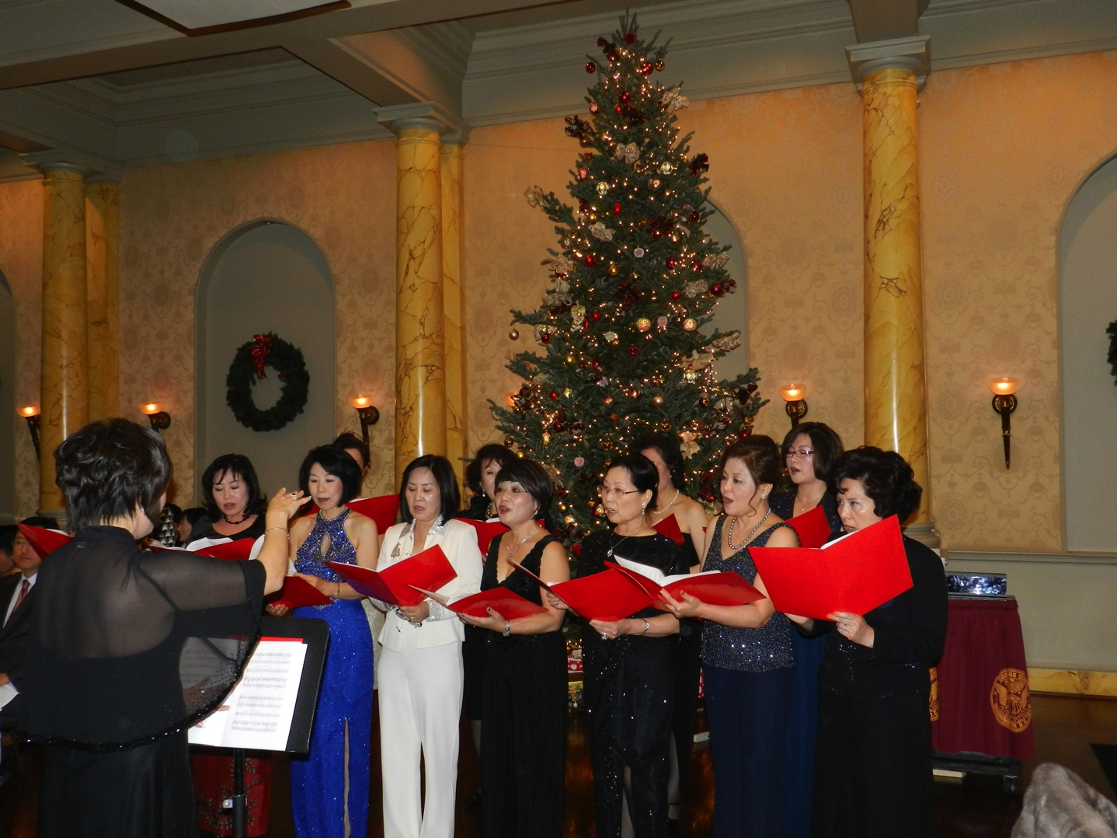

Slide 12

[Reports on January– August, 2012 Activities]
2012 KOWIN DC Chapter Member Retreat
  Time and place: January 27th to 29th, 2012, Berkeley Spring, West Virginia
  Approximately 9 members, which included both old and new members, attended this social gathering
  They created new relationships and became closer through activities. There was a discussion on how to support and develop young women leadership.
  Activities:
    New KOWIN DC Junior member: Judi Rhee Alloway, the president of a women’s business center, led a leadership training activity
    Separated into several teams in order to do different team-bonding activities and develop leadership skills
    Tour of the Berkeley Spring area and spa from the natural spring water
    Bonding and networking among the members who attended this event

Slide 13
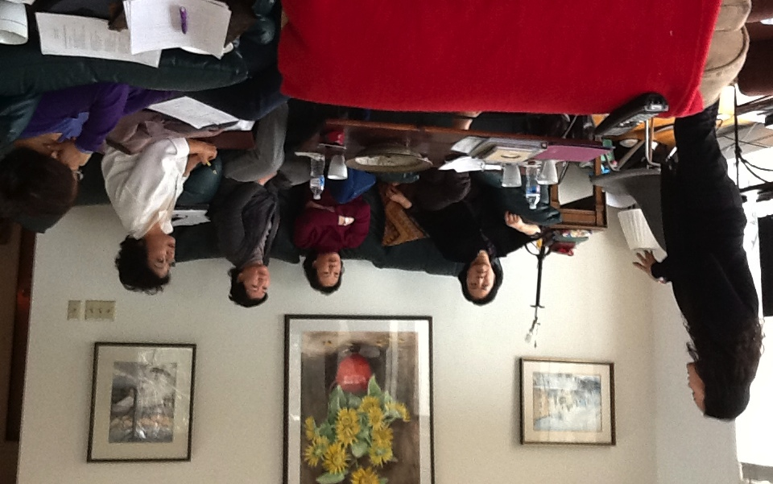
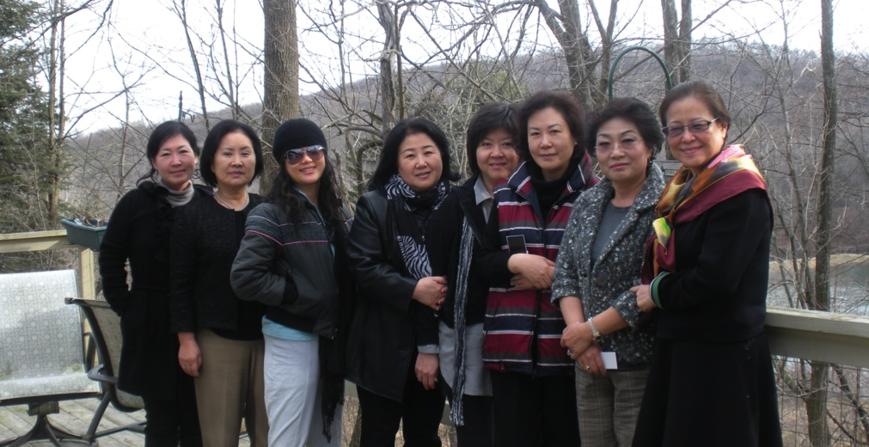

Slide 14
[Reports on January– August, 2012 Activities]
2012 1st Membership Meeting
  March 27th, 2012, Woo lae Oak (Tyson’s Corner)
  Including the invited guest speaker and new members, a total of 30 people attended
  Main Content
    Lieba Macias, Financial Advisor, (MERC Capital Management and FSC Stock Fund) spoke about a special topic
    “Preparation for a Woman’s Retirement”
    KOWIN International Convention at Yeosu in August 2012 was announced
    The DC members who will attend the KOWINNER in Romania in June 2012 were announced, and the program of that event was introduced
    The Financial Report for 2011 was discussed
    The new and old executive members were introduced
    KWACC was introduced by Young suh Park
    The meeting was conducted in English for those who were not bilingual in both English and Korean

Slide 15
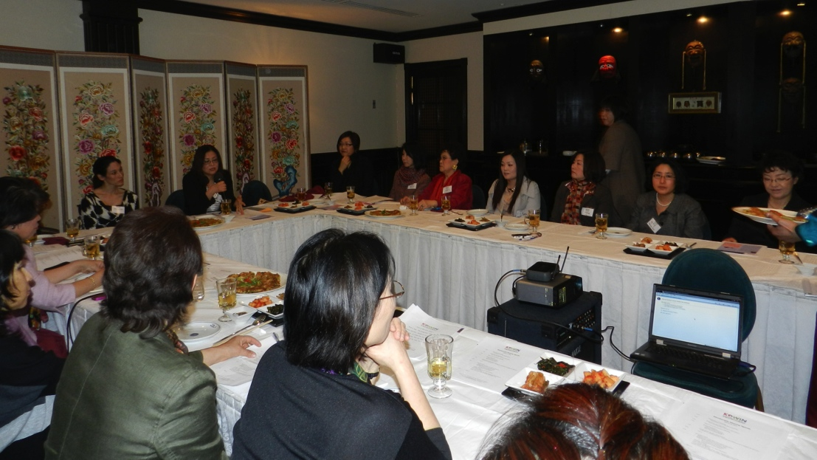
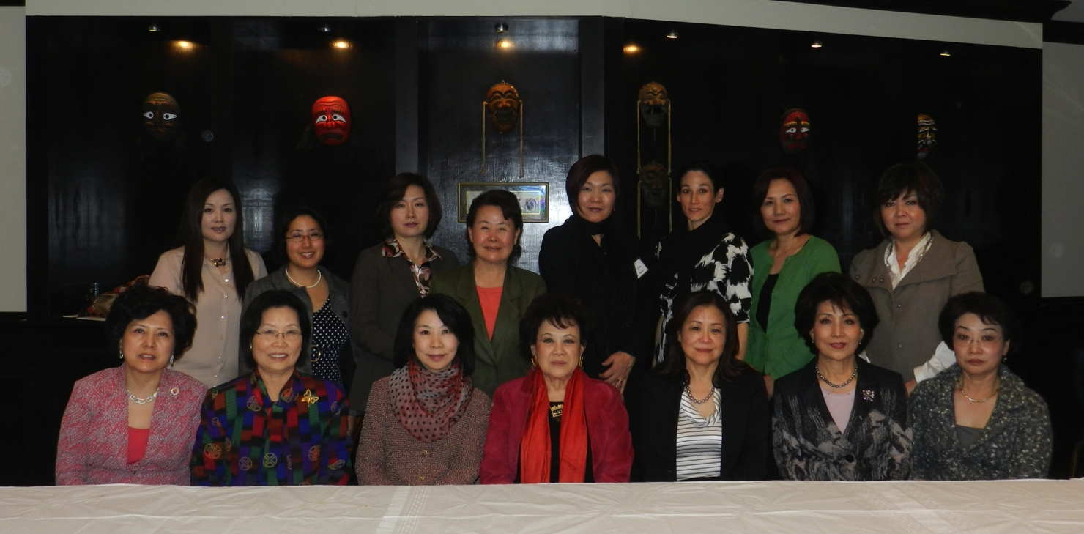

Slide 16
2012-2013 KOWIN DC Chapter Fellowship
  April 2012, new KOWIN DC Fellow application and decision
    The Chosen Fellow: Margaret Susie Won
    This is a one-year fellowship for the DC chapter in which the fellow attends all the chapter’s functions, so that the fellow can gain experience and learn from fellow Korean women professionals
    The fellow must have graduated from undergraduate school or Master’s or PhD
    The period begins in August. The airfare to Korea in order to attend the KOWIN International Convention is given. The fellow is mentored by a professional in her chosen field. Every month, the fellow is given a stipend.

Slide 17
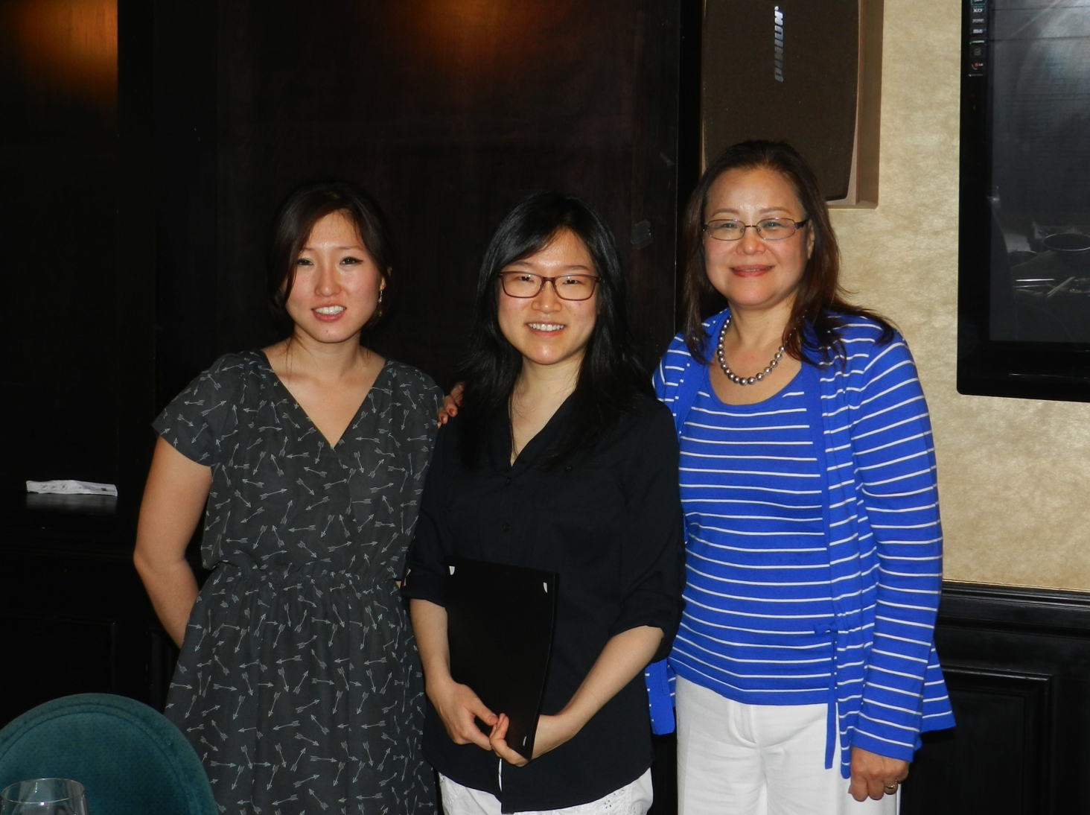

Slide 18
[Reports on January– August, 2012 Activities]
Third KOWINNER Convention in Romania
Time and Location: June 15th -17th Bucharest, Romania
Purpose
  Korean women from all over the world gathered with their various professions. They shared their stories about their successes, experience and wisdom within the different cultures that they are from. They shared their culture amongst one another by performing special music and art-related acts.
Main Content
  From 21 different countries, 90 people attended. From the KOWIN DC Chapter, five members attended: Myong-ho (Lucy) Nam (President), Hong Ja Kim, Sue-Kyong Shin-Vittas, Sami Lauri, and Susan Oh
  Congratulatory Speech: In Choon Son, Korean Congressman and Han Taek Im, Korean Ambassador to Romania
  21 worldwide famous artist awards were given for promoting Korea
  ‘International Women Artists Award’
    KOWIN DC Chapter Award Recipient: Hong Ja Kim
    Cultural Seminars
    Hong Ja Kim: ‘The Last 40 Years of my Artist Life”
    Sue-Kyong Vittas-Shin: ‘International Dinner Party Etiquette’

Slide 19
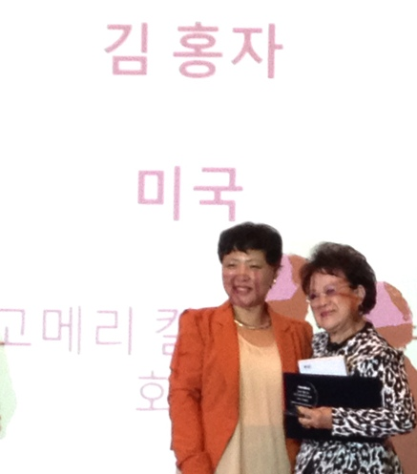
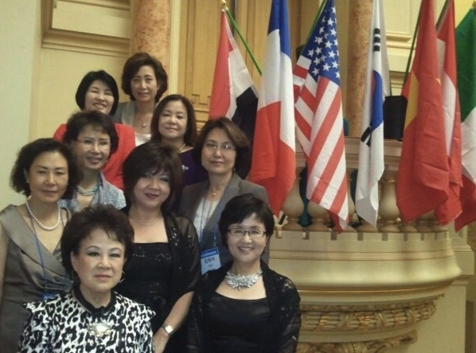
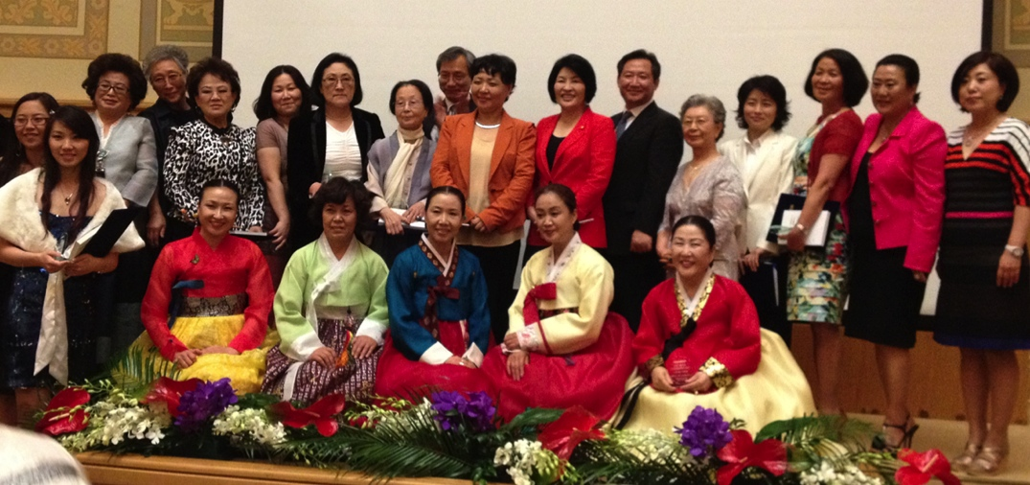

Slide 20
[Reports on January– August, 2012 Activities]
2012 2nd Membership Meeting
  Date and Location: July 12th, 2012, Woo Lae Oak (Tyson’s Corner) 16 people attended
  Main Content:
    Vice President Jung Hee Lee began with a welcoming speech and introduced new members
    3rd KOWINNER Slideshow with pictures and videos were shown. Also it was announced that the 4th KOWINNER Convention will be held in New Delhi, India in January 2014
    The previous fellow, Erika Shin, was presented a certificate of completion and subsidy for her work
    2012-2013 New Fellow, Margaret Susie Won, was introduced and gave a introductory speech
    2012 Half-Year Report on the new, upcoming events(Leadership Seminar, Christmas Gala etc.) by the Committee chairs
    Updated news, preparation and planning for the events
      Seminar Committee: They are trying to confirm the Key-note Speaker from a list of four people
      Gala Committee: They had July meeting. There are 10 people on the committee.
      Fundraising Committee: New committee co-chair, Dr. Suzanne Kim Doud Galli, presented her Glycolic Peel Promotion in order to raise funds for the KOWIN DC fellowship
    The decision on who will attend the August 12th KOWIN International Convention in Yeosu, Korea was announced
      DC Chapter President, Myong-ho (Lucy) Nam, Stella Yi, Helen Won, Judi Rhee Alloway, Suzanne Kim Doud Galli, Sue-Kyong Vittas-Shin as well as Fellow, Margaret Susie Won. There is a total of 8 members attending.

Slide 21
